Slide 1

Advanced topics Thomas Künneth
https://unsplash.com/photos/27LH_0jXKYI

Slide 2
Questions 🤔

Slide 3
Let‘s recap
Three main types of visual composable functions
Traditional UI elements
Layouts
Composables that do something else (stringResource(), …)
In Compose it is ok to nest layouts

Slide 4
In this session, we’ll cover
App-level user interface
Scaffold() with app bar and options menu
ModalBottomSheet()
Animations

Slide 5
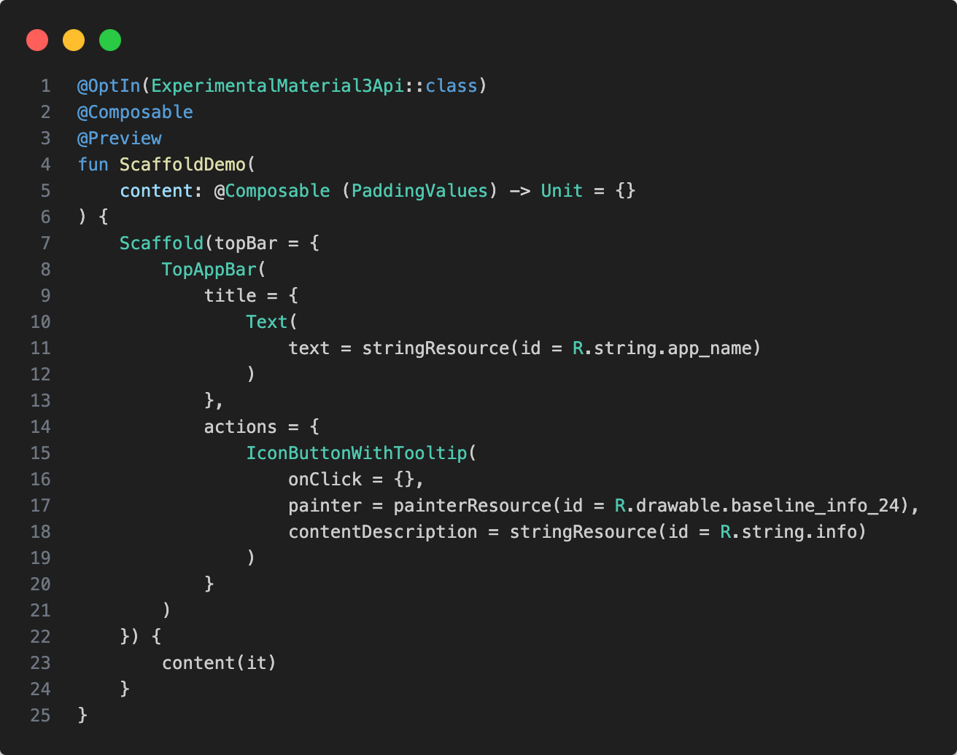
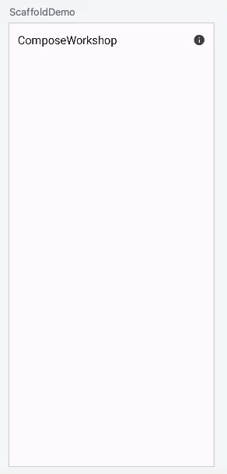

Slide 6
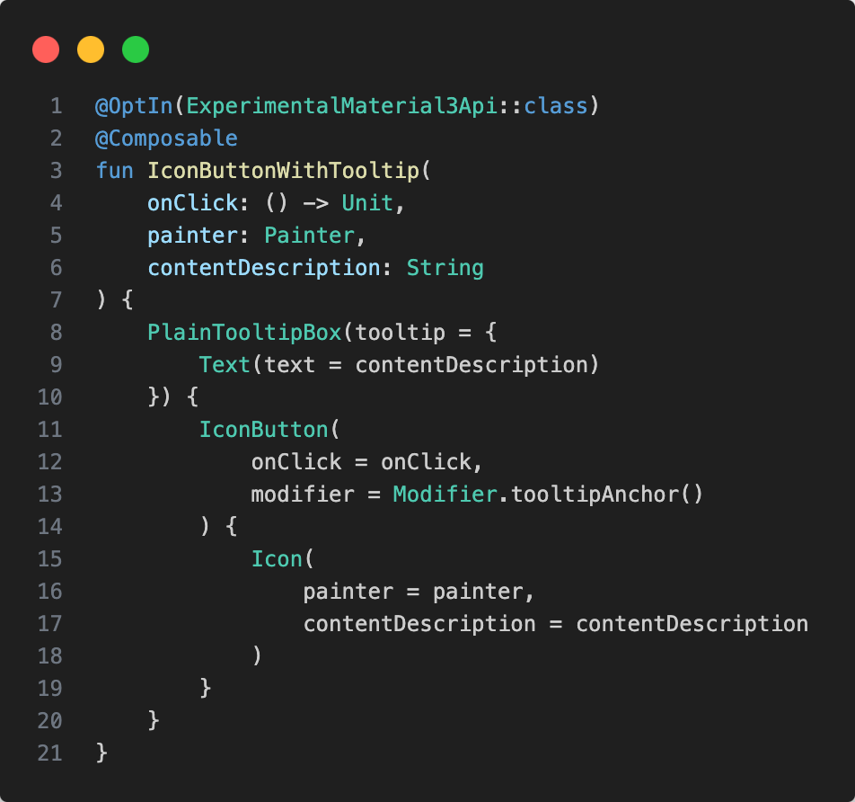

Slide 7
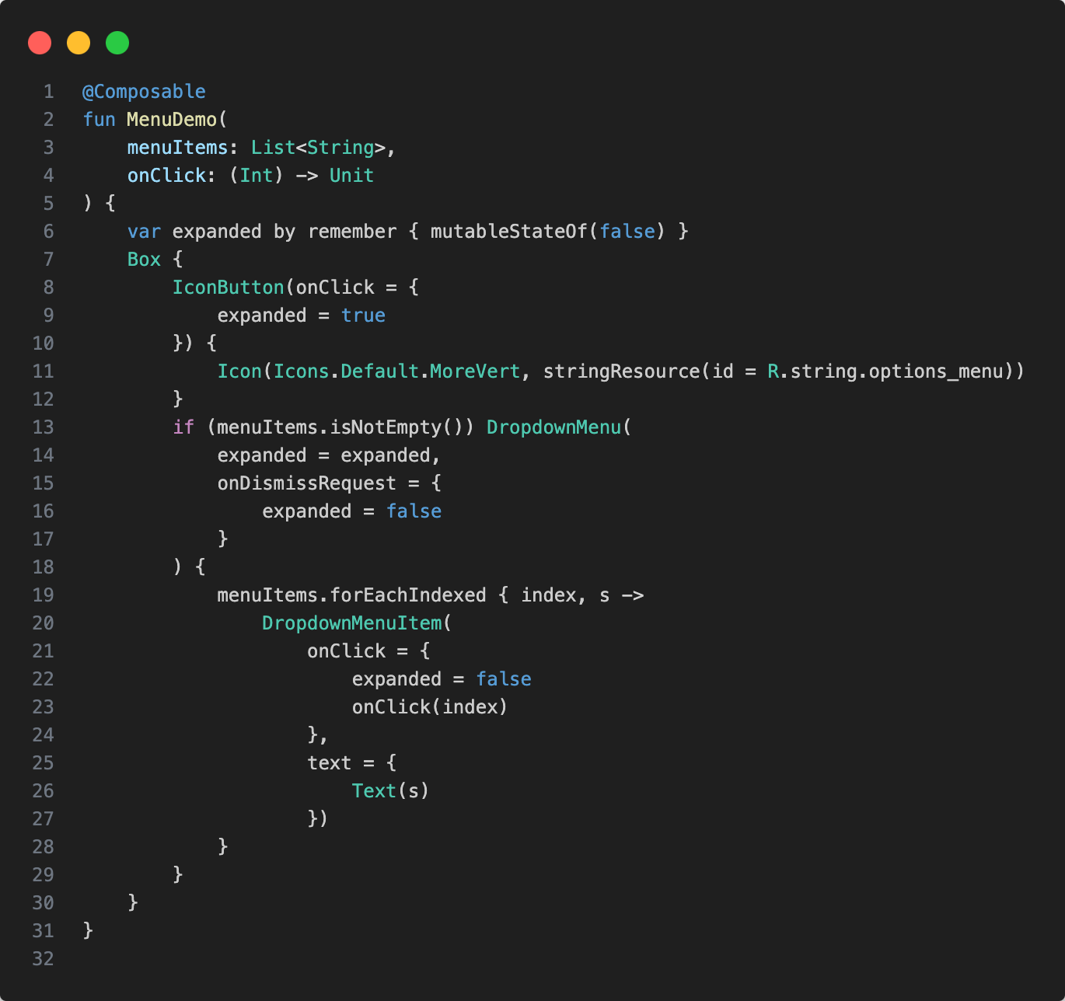
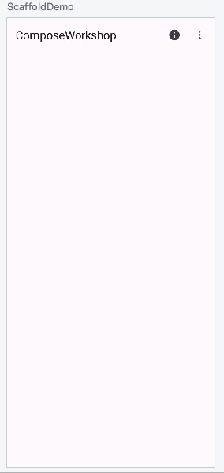

Slide 8
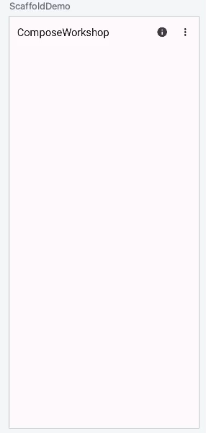
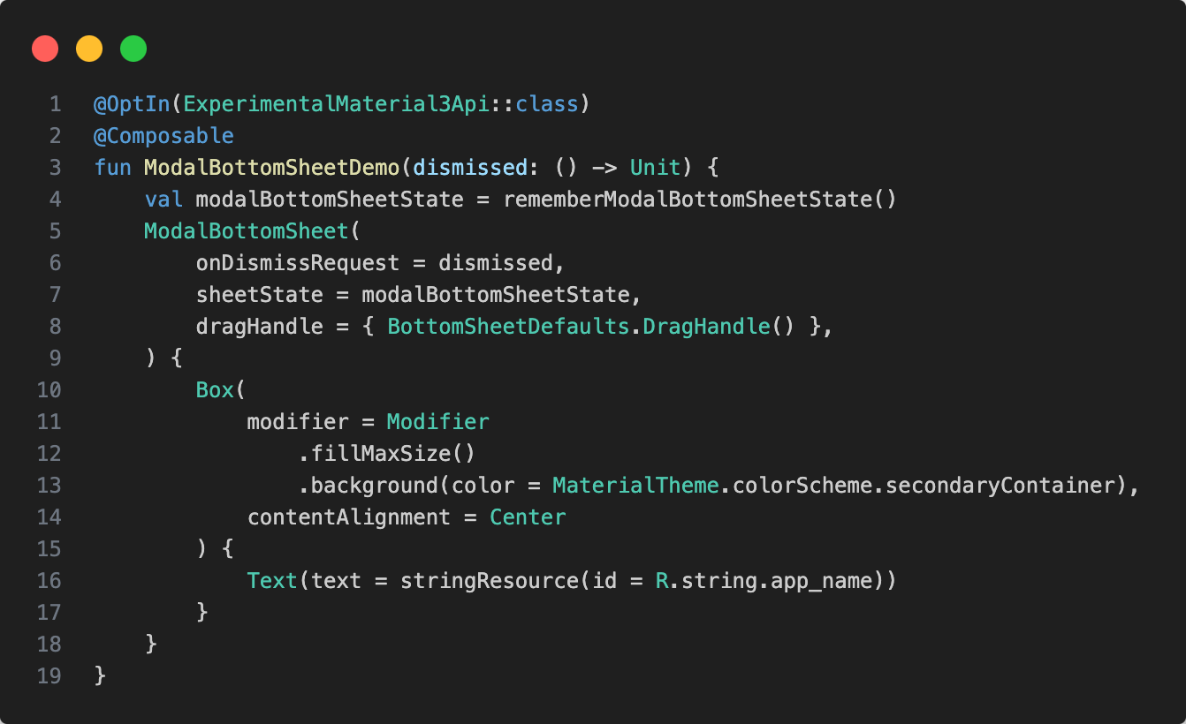

Slide 9
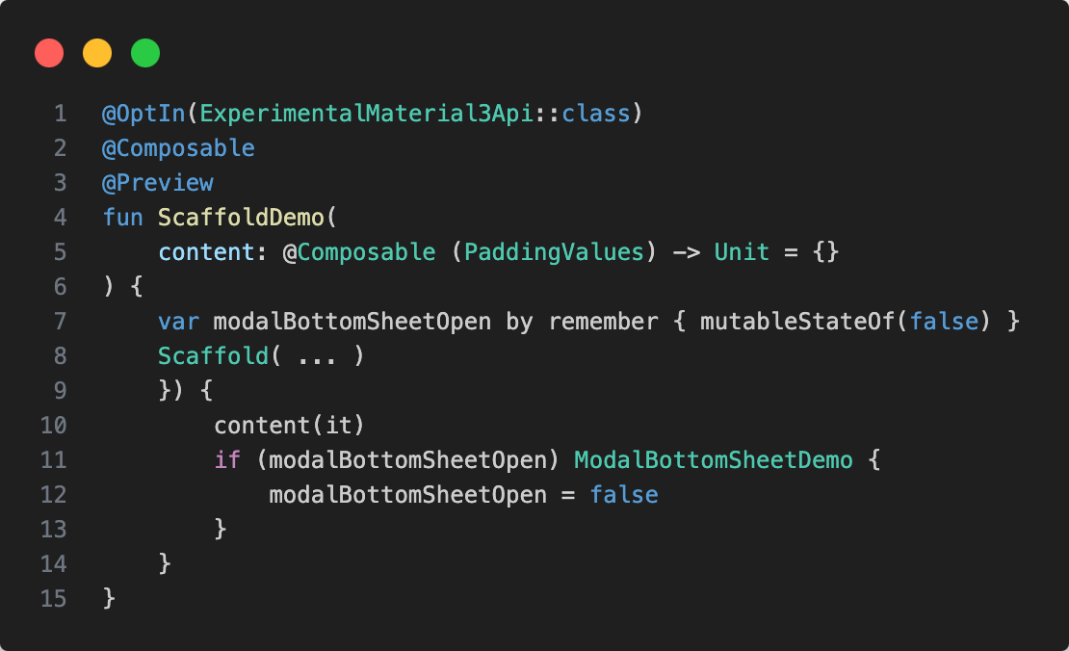

Slide 10
Animations
Have become very important
Not easy to achieve using Views
But seamlessly integrated into Jetpack Compose

Slide 11
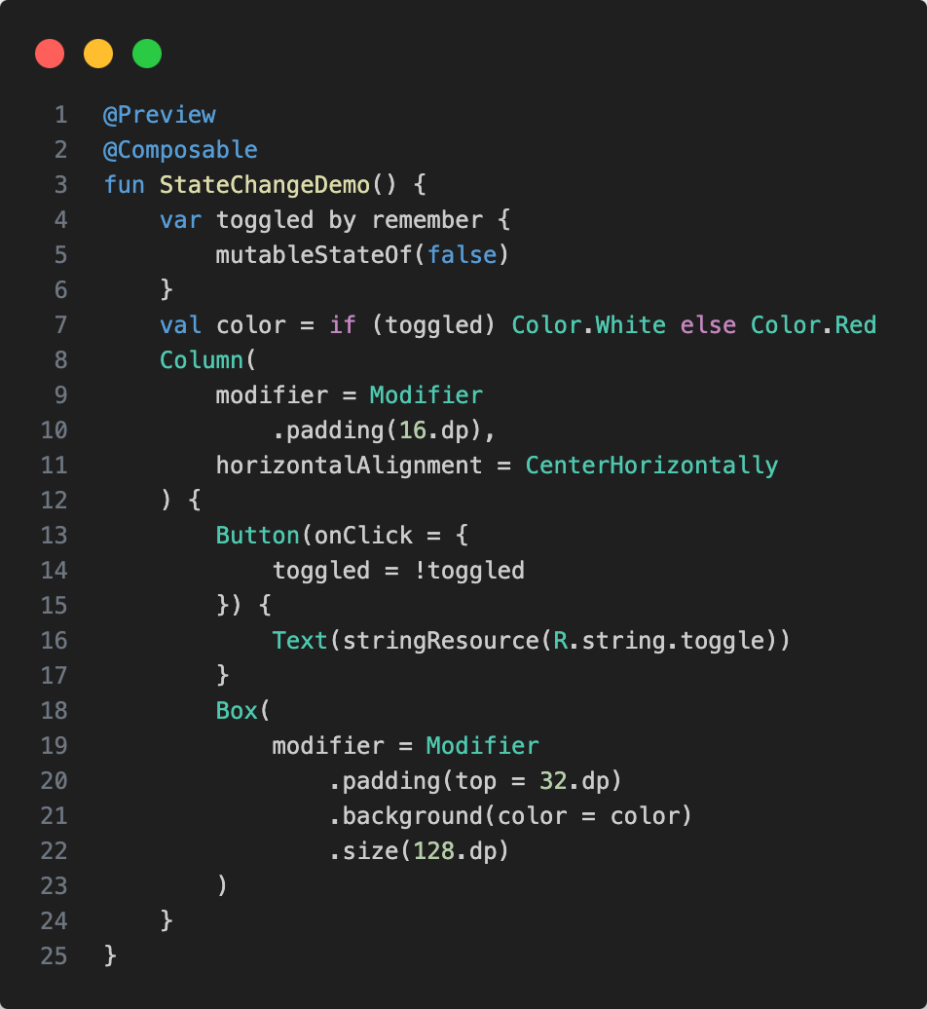
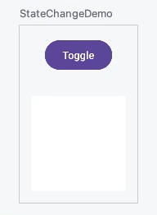

Slide 12
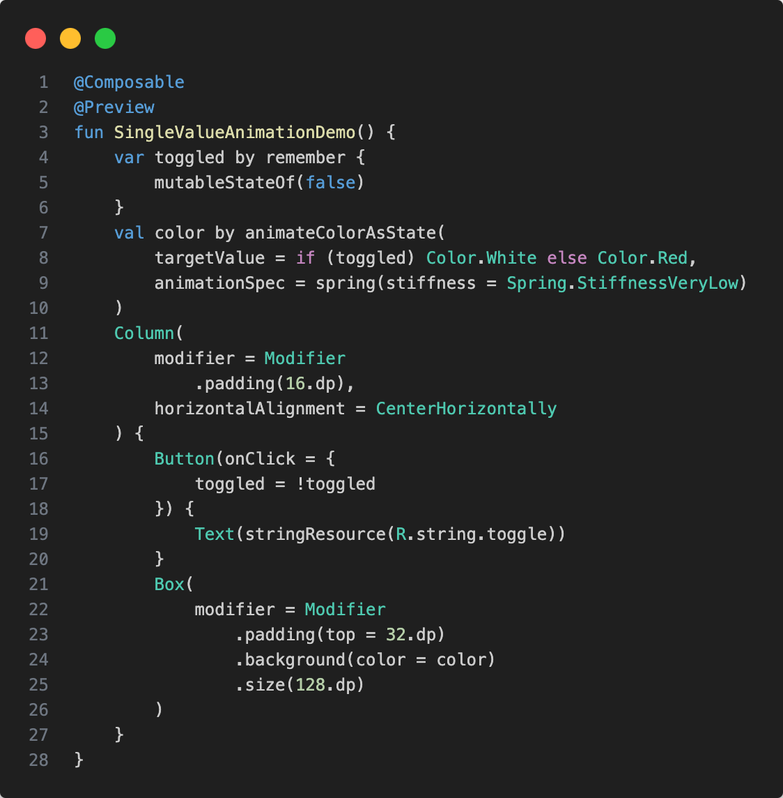
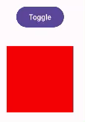

Slide 13
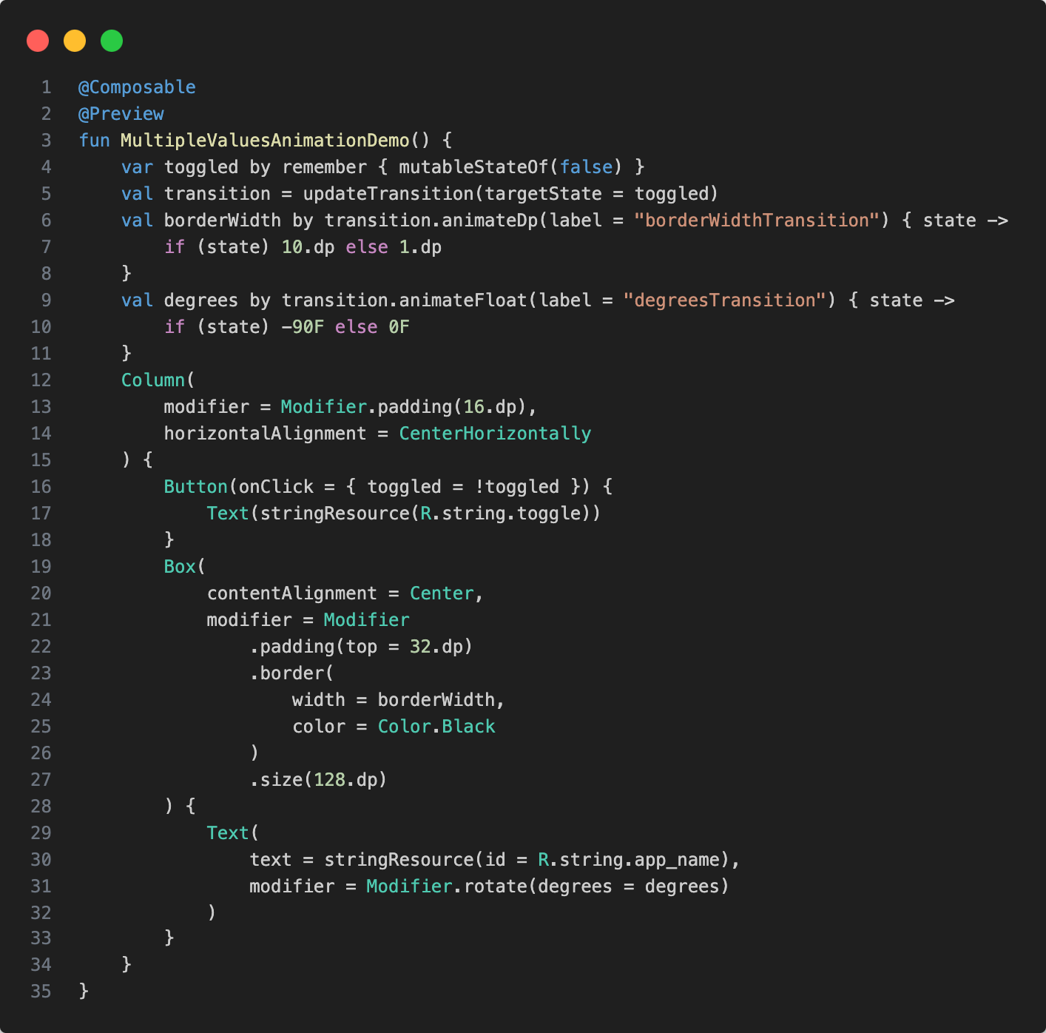
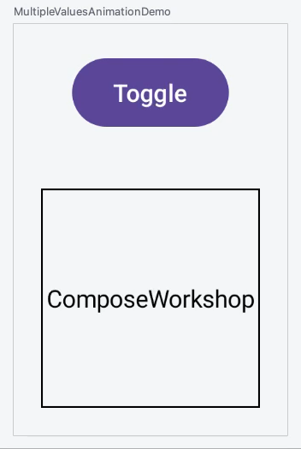

Slide 14
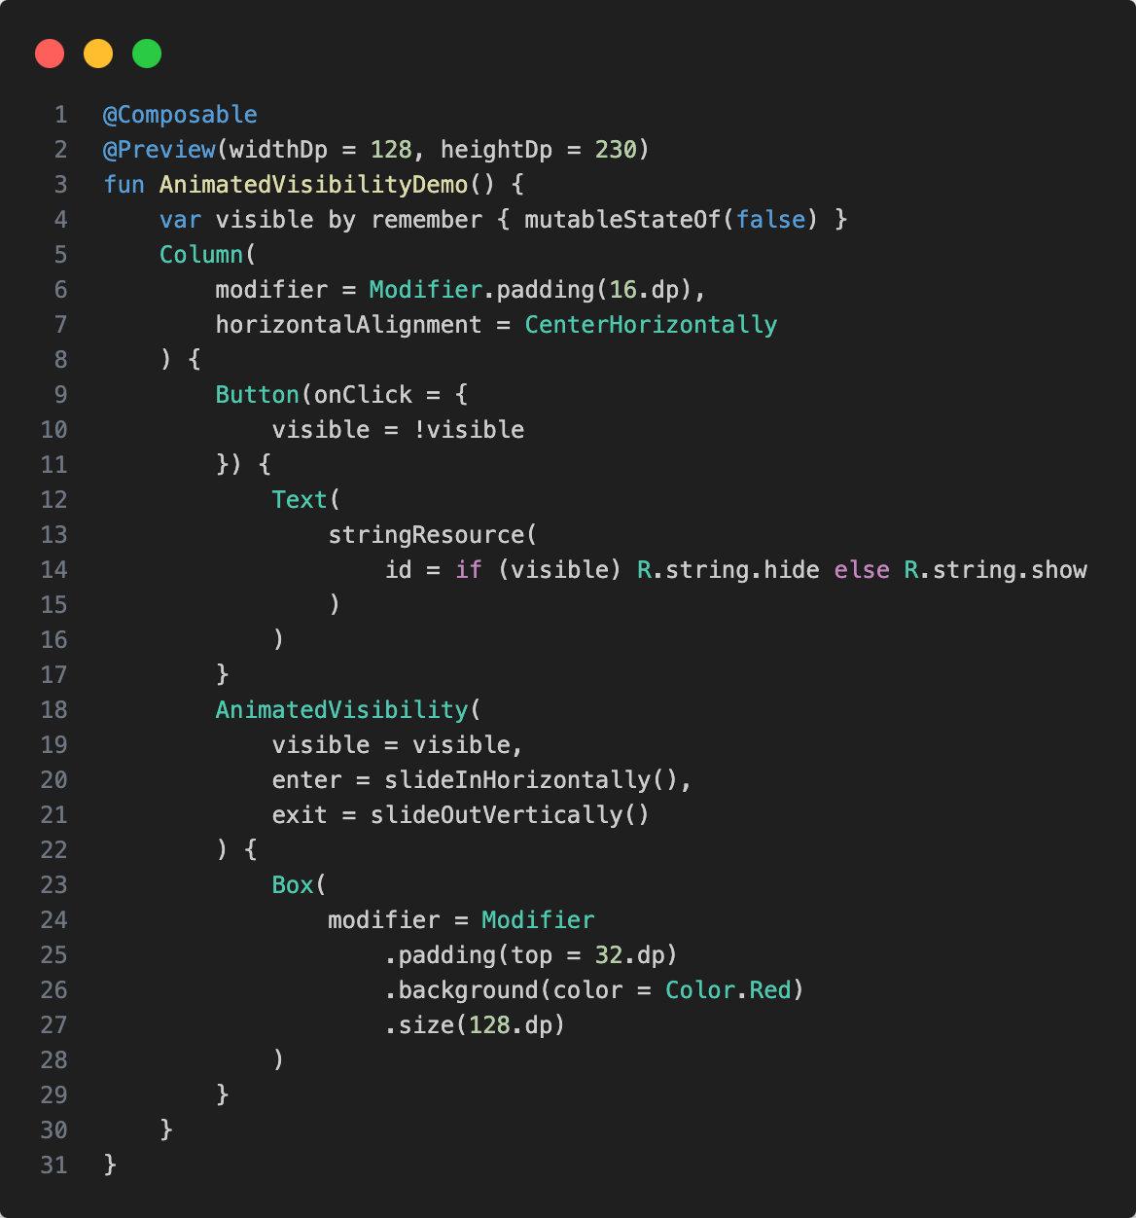
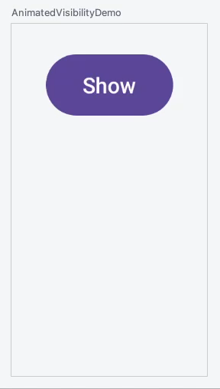

Slide 15
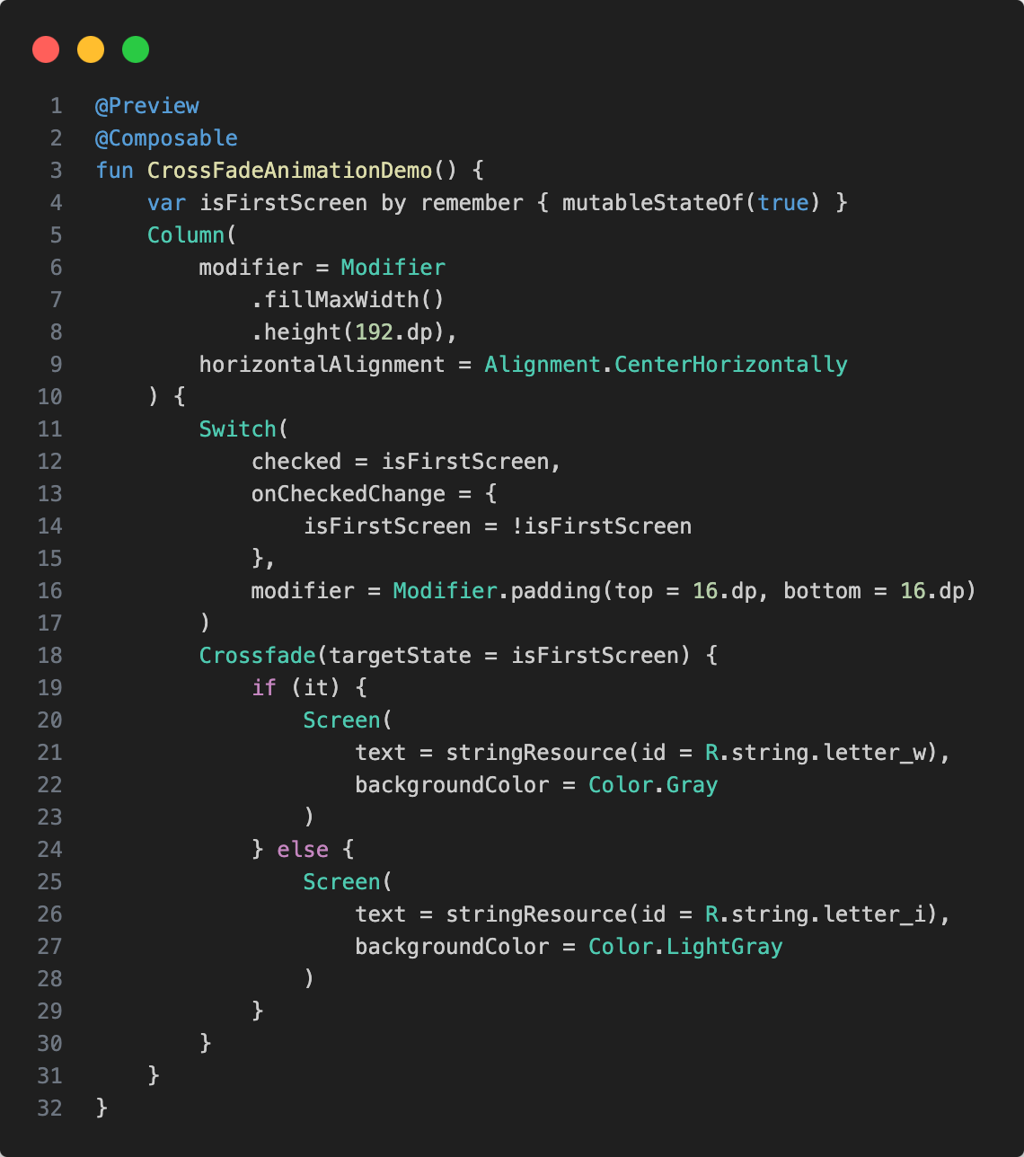
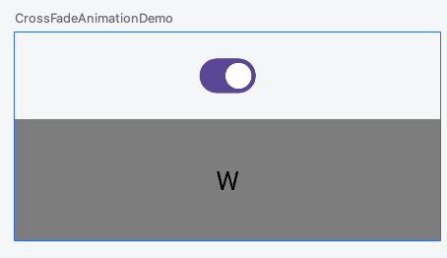

Slide 16
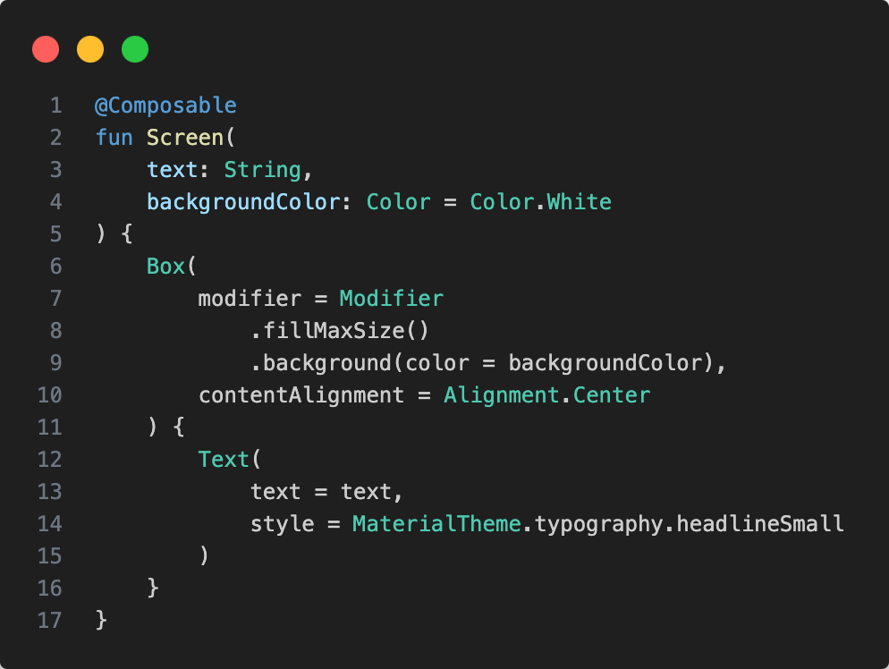

Slide 17

Exercise
https://unsplash.com/photos/IZOAOjvwhaM

Slide 18
Switch to branch 03_building_uis of the compose_workshop repository (https://github.com/tkuenneth/compose_workshop)
Add a Scaffold() with an action that shows a bottom sheet
Add a content composable to the Scaffold() that shows some animations
A working version can be found on branch 04_advanced_topics

Slide 19

Short break… 😍

